Slide 1


8th May 2014
WORKSHOP ON SKILL DEVELOPMENT IN MEGHALAYA: A WAY FORWARD
© IL&FS Institute of Skill 2014

Slide 2
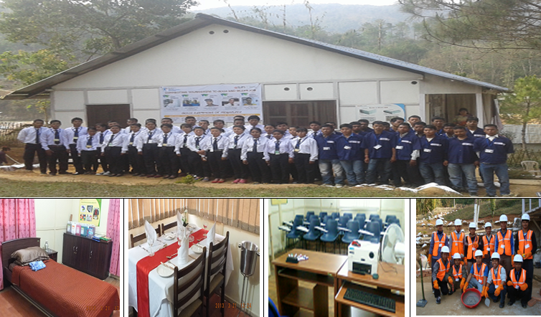
1st IL&FS Skills School started functioning at Pyllun Village, RiBhoi : 18th July, 2011
1st Batch: Sponsorship- SGSY-SP, MoRD, Govt. of India
Training Capacity: 30, Trade: Facility Management Services
© IL&FS Institute of Skill 2014

Slide 3
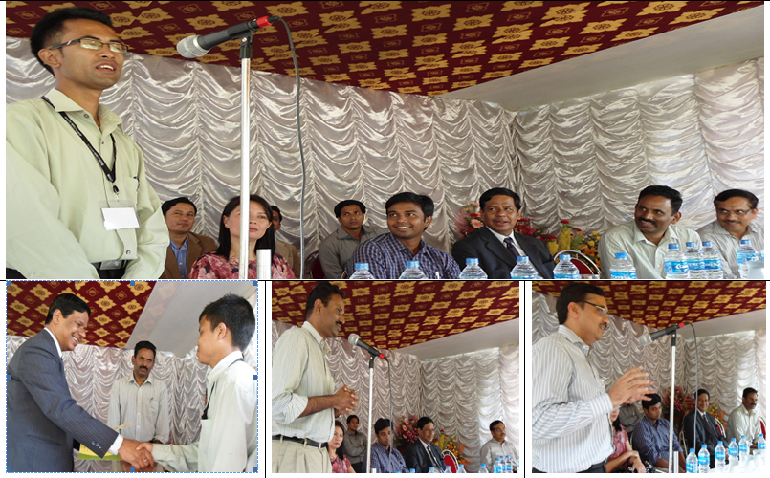
(1st Batch: Enrolled-17, Completed-9, Placed-9 )
Graduation Day-8th Aug, 2011
Chief Guest: Shri WMS Pariat, IAS, Chief Secretary to Govt. of Meghalaya
© IL&FS Institute of Skill 2014

Slide 4
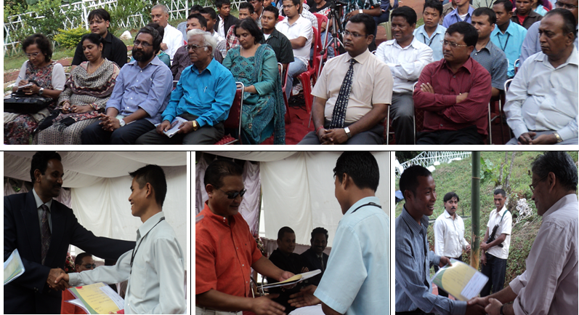
(2nd Batch: Enrolled- 34, Completed-28, Placed-28 )
Graduation Day-17th Oct, 2011
Chief Guest: Shri S Sangma, Honourable Minister, Community & Rural Development, Govt. of Meghalaya
© IL&FS Institute of Skill 2014

Slide 5
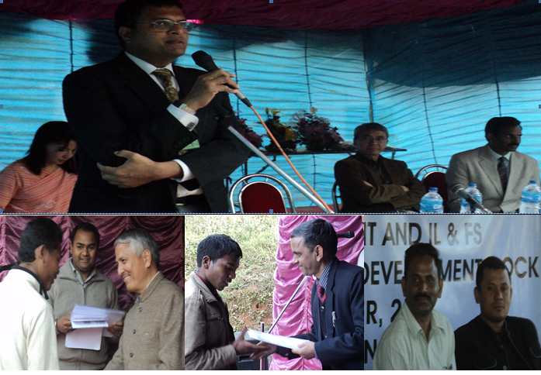
3rd Batch: Enrolled- 21, Completed-21, Placed-21
4th Batch: - Enrolled- 26, Completed-26, Placed-26
On 6th Dec’2011 Chief Guest: Shri. PBO Warjri, IAS, Addl. Chief Secretary, GoM
On 11th Jan, 2012 Chief Guest: Shri. K.S.Kropha, IAS, Principal Secretary, GoM
© IL&FS Institute of Skill 2014

Slide 6
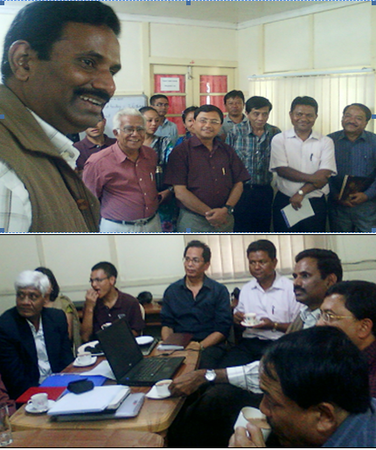
Shri KN Kumar, IAS , Principal Secretary to GoM- C&RD
With senior GoM officials across departments
© IL&FS Institute of Skill 2014

Slide 7
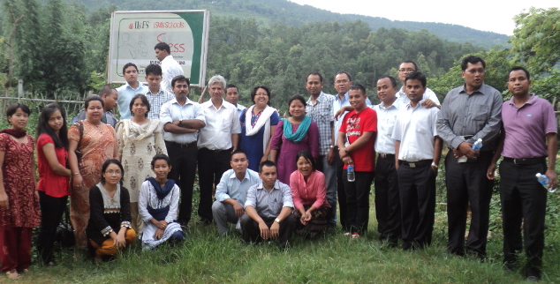
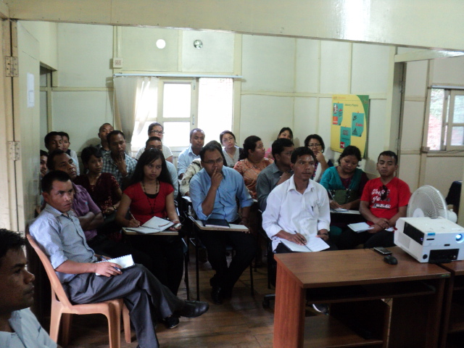
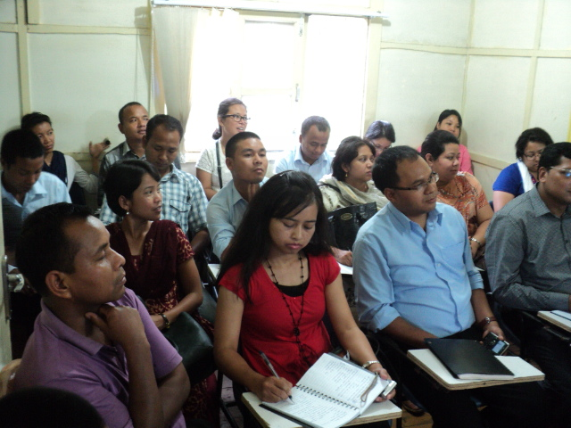
Team of MCS officials visited ISS Barapani: 28th July, 2012
© IL&FS Institute of Skill 2014

Slide 8
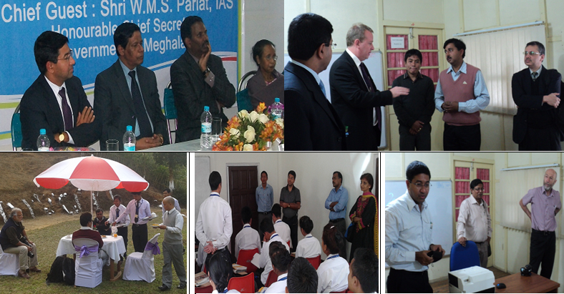
ADB Visits
Sep,2012 to July,2014
© IL&FS Institute of Skill 2014

Slide 9
IL&FS Skills-Progress @ Meghalaya
FY | Trainees Completed Training
FY-11-12 | 195
FY-12-13 | 1160
FY-13-14 | 985
FY-14-15 | 1297
Total | 3637
FY | No. Of Mandates implemented | Mandates
FY-11-12 | 1 | SGSY-SP, GoI
FY-12-13 | 2 | SGSY-SP, GoI & Directorate of Tourism, GoM
FY-13-14 | 5 | SGSY-SP-GoI ,Directorate of Tourism-GoM, DECT-GoM, SIRD-GoM, MoMA-GoI
FY-14-15 | 5 | SGSY-SP-GoI ,Directorate of Tourism-GoM, DECT-GoM, SIRD-GoM, MSSDS-GoM
© IL&FS Institute of Skill 2014

Slide 10
IL&FS Skills-Progress @ Meghalaya
FY | No. Of Centres Functional
FY-11-12 | 3
FY-12-13 | 7
FY-13-14 | 7
FY-14-15 | 5
Name of Skills Training Center | Period: Functional
IL&FS Skills School-Pyllun | 18.07.11 | 25.02.15 | 3 yrs. 7 Mts.
IL&FS Skills School-Rimrangpara | 16.02.12 | 17.10.12 | 8 Mts.
IL&FS Skills School-Mawthadraishan | 01.03.12 | 09.02.13 | 11 Mts.
IL&FS Skills School-Umsning | 18.05.12 | N/A | CONT.
IL&FS Skills School-Rongjeng | 05.10.12 | 16.10.13 | 12 Mts.
IL&FS Skills School-Williamnagar | 28.11.12 | N/A | CONT.
IL&FS Skills School-Khliehriat | 22.02.13 | 05.03.14 | 1 Yr 1 Mt.
IL&FS Institute of Skills-Shillong | 25.04.13 | N/A | CONT.
IL&FS Skills School-Resubelpara | 08.11.13 | N/A | CONT.
© IL&FS Institute of Skill 2014

Slide 11
Placement Linked Skills Development Mandates @ Meghalaya
SGSY-SP, GoI
Enroled | 1605
Completed Training | 1509
Placed | 965
Dir. Of Tourism, GoM
Enroled | 1150
Completed Training | 1038
Placed | 748
MSSDS, GoM
Enroled | 1150
Completed Training | 835
Placed | 595
© IL&FS Institute of Skill 2014

Slide 12

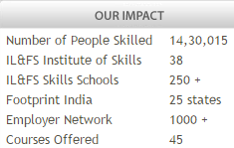
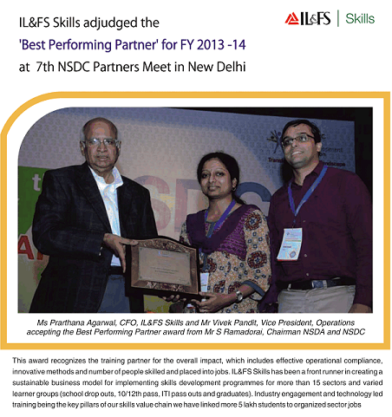
IL&FS Skills Development Corporation Limited
Evolved as India’s LARGEST Skills Company
© IL&FS Institute of Skill 2014

Slide 13
Mandate From Meghalaya State Skills Development Society (MSSDS)
Progress – As on 31st Mar, 2015
Trade | Enrolled | Dropped | Completed | % | Placed
Hospitality | 625 | 101 | 474 | 58 | 318
SMO | 150 | 22 | 128 | 16 | 126
Basic Electrician | 220 | 30 | 173 | 21 | 56
Asst Mason | 36 | 10 | 29 | 4 | 29
Retail | 13 | 3 | 10 | 1 | 4
TOTAL | 1044 | 166 | 814 | 100 | 533
Connecting People through SKILLS
© IL&FS Institute of Skill 2014

Slide 14
Trainee Profile
School Drop-out | Completed | %
V-VIII | 97 | 12
IX-under X | 481 | 59
X-under XII | 180 | 22
XII & above | 56 | 7
TOTAL | 814 | 100
Gender | Completed | %
Boys | 596 | 73
Girls | 218 | 27
Total | 814 | 100
Category | Completed | %
ST | 760 | 93
SC | 11 | 1
General | 38 | 5
OBC | 5 | 1
Total | 814 | 100
Religion | Completed | %
Christian | 766 | 94
Hindu | 37 | 5
Mulsim | 11 | 1
Other | 0 | 0
Total | 814 | 100
© IL&FS Institute of Skill 2014

Slide 15
District Wise Coverage
District | Completed | %
Ribhoi | 26 | 3
East Khasi Hills | 95 | 12
West Khasi Hills | 183 | 22
South West Khasi Hills | 4 | 0
Jaintia Hills | 7 | 1
East Jaintia Hills | 32 | 4
North Garo Hills | 117 | 14
East Garo Hills | 120 | 15
West Garo Hills | 124 | 15
West Jaintia Hills | 27 | 3
South West Garo Hills | 53 | 7
South Garo Hills | 26 | 3
TOTAL | 814 | 100
© IL&FS Institute of Skill 2014

Slide 16
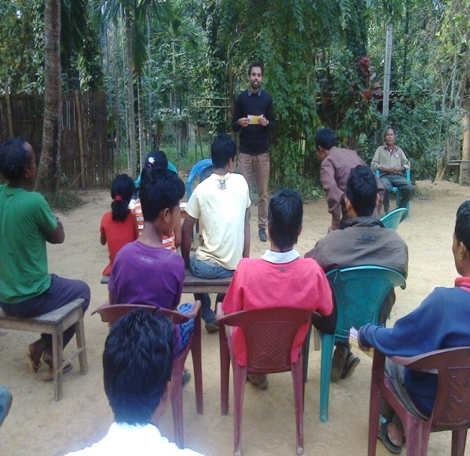
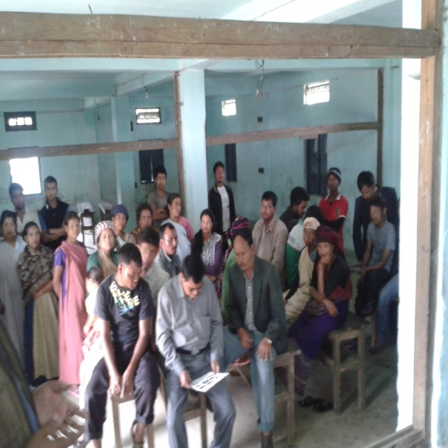
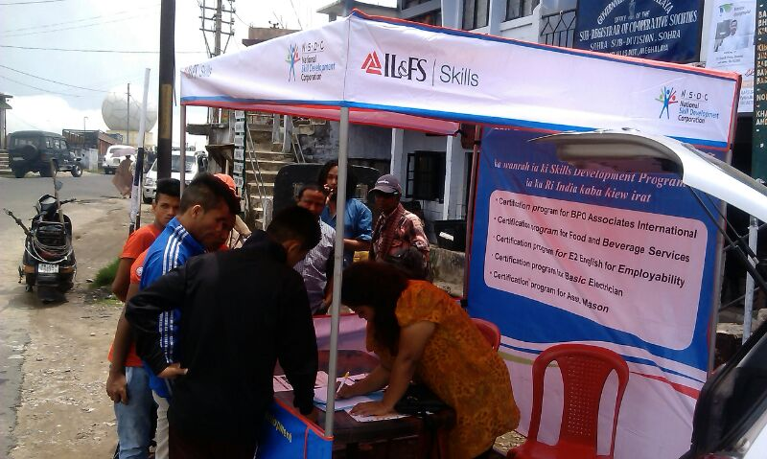
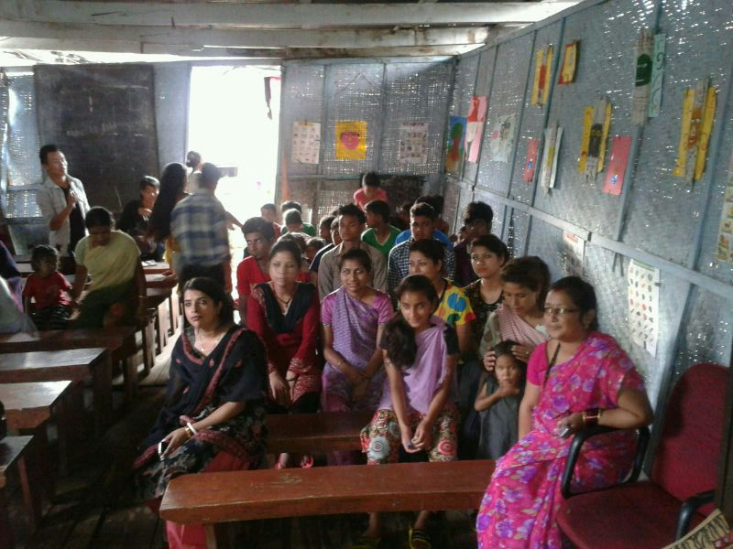
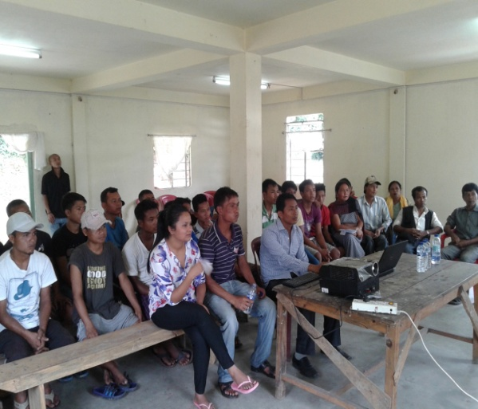
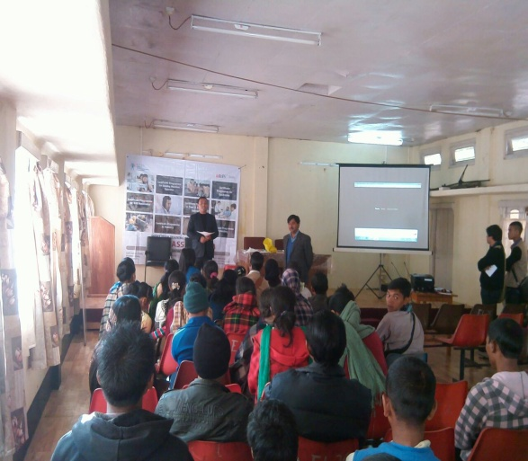
Community Mobilization
© IL&FS Institute of Skill 2014

Slide 17
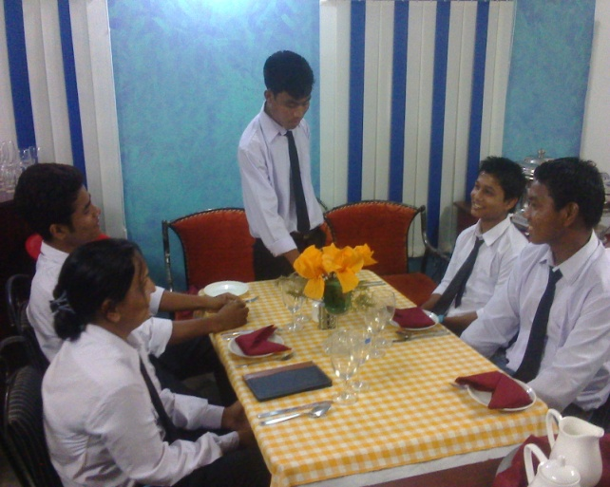
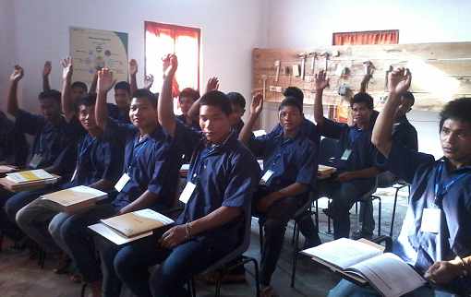
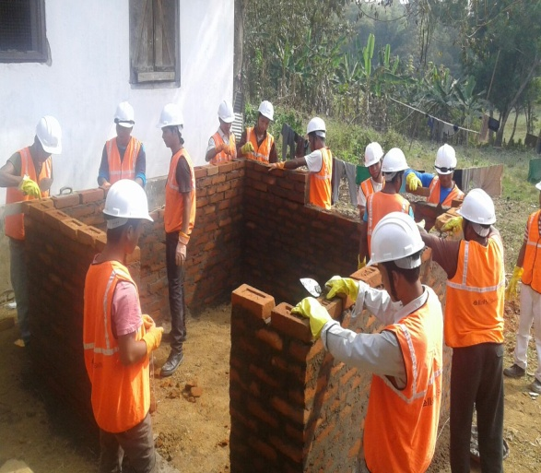
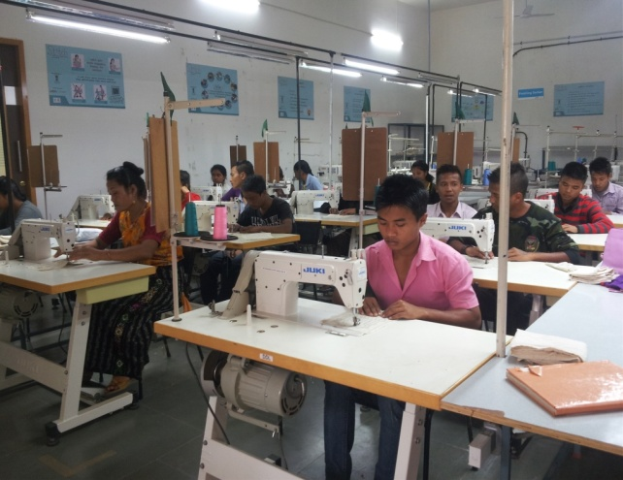
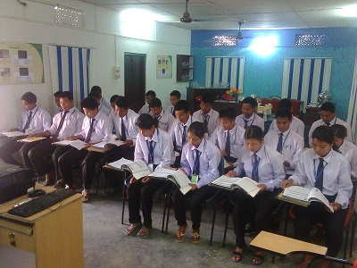
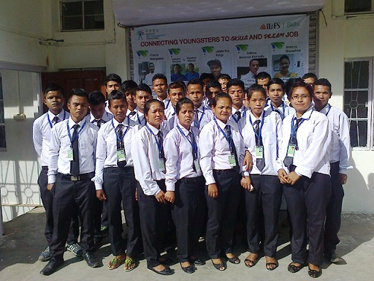
Training
© IL&FS Institute of Skill 2014

Slide 18
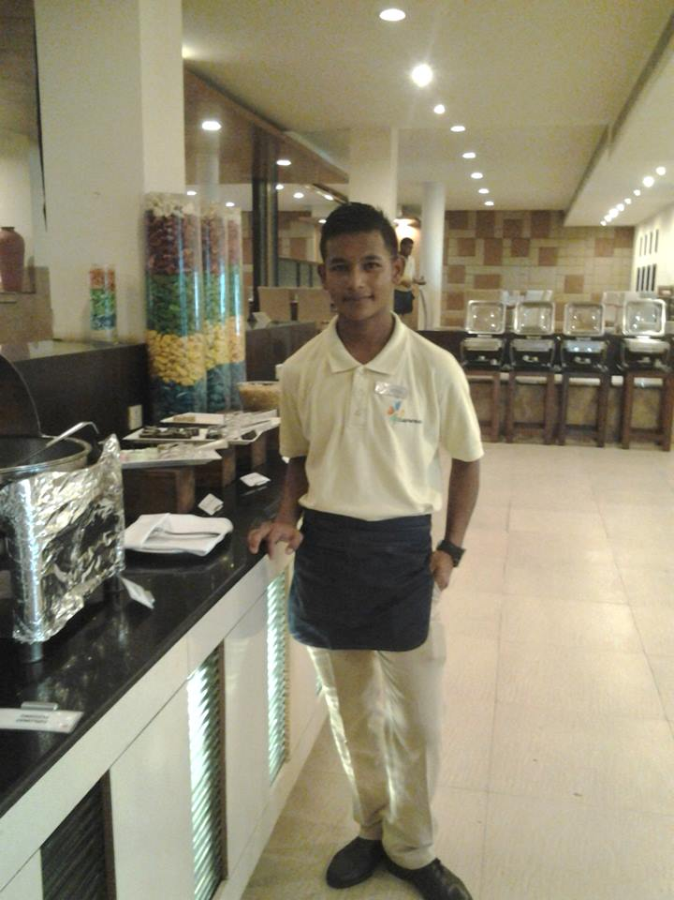
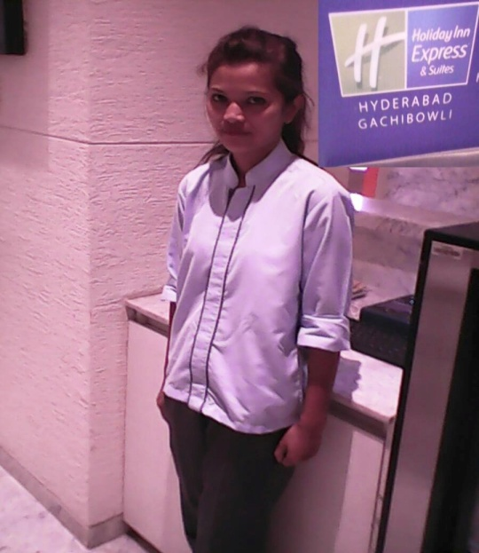
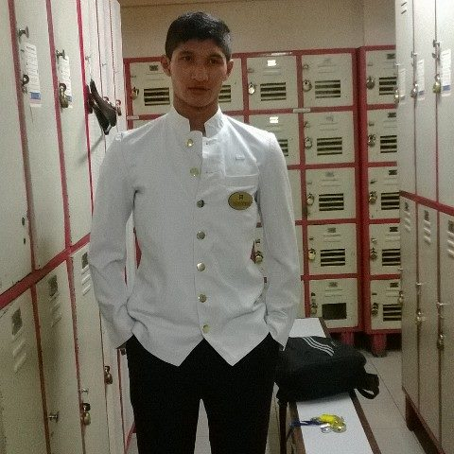
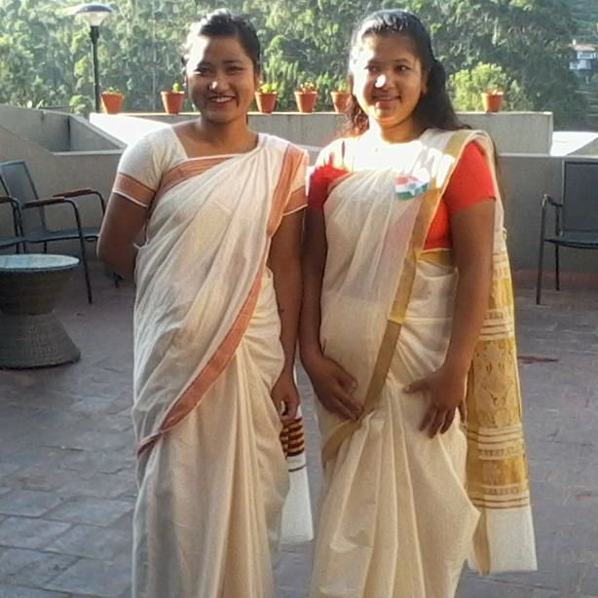
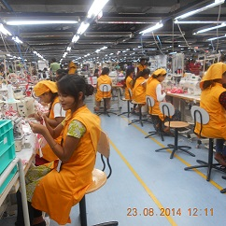
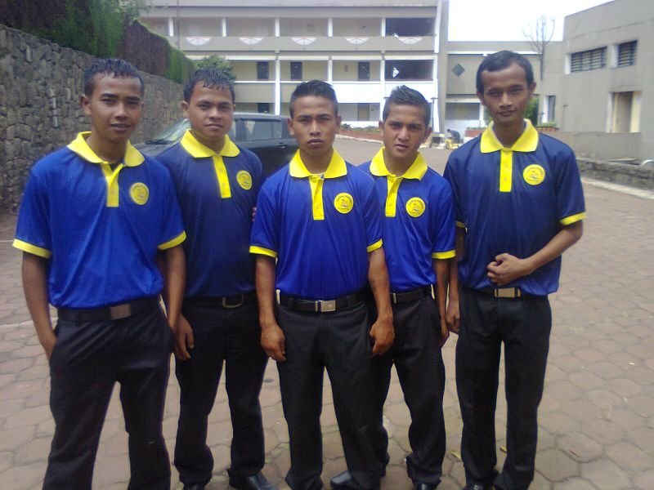
Placement
© IL&FS Institute of Skill 2014

Slide 19
Thank You
2nd Floor, NL Complex
Dhankheti, Shillong
Meghalaya
© IL&FS Institute of Skill 2014

