Slide 1

A Presentation on MSSDS Experience of Skill Development

Slide 2
About MSSDS
The Meghalaya State Skills Development Society (MSSDS) has been notified by the Government to find ways and means to tackle the problem of employability of the youths.
NIPFP study estimates that “27% of the state’s population is between 15-29 years”. It is against this backdrop that the Meghalaya State Skills Development Society (MSSDS) was established on 5th December 2011 to promote employment skill formation in Meghalaya.

Slide 3
MSSDS vision
To enhance the skill-sets of youths (18 – 35 years) so their employability improves.

Slide 4
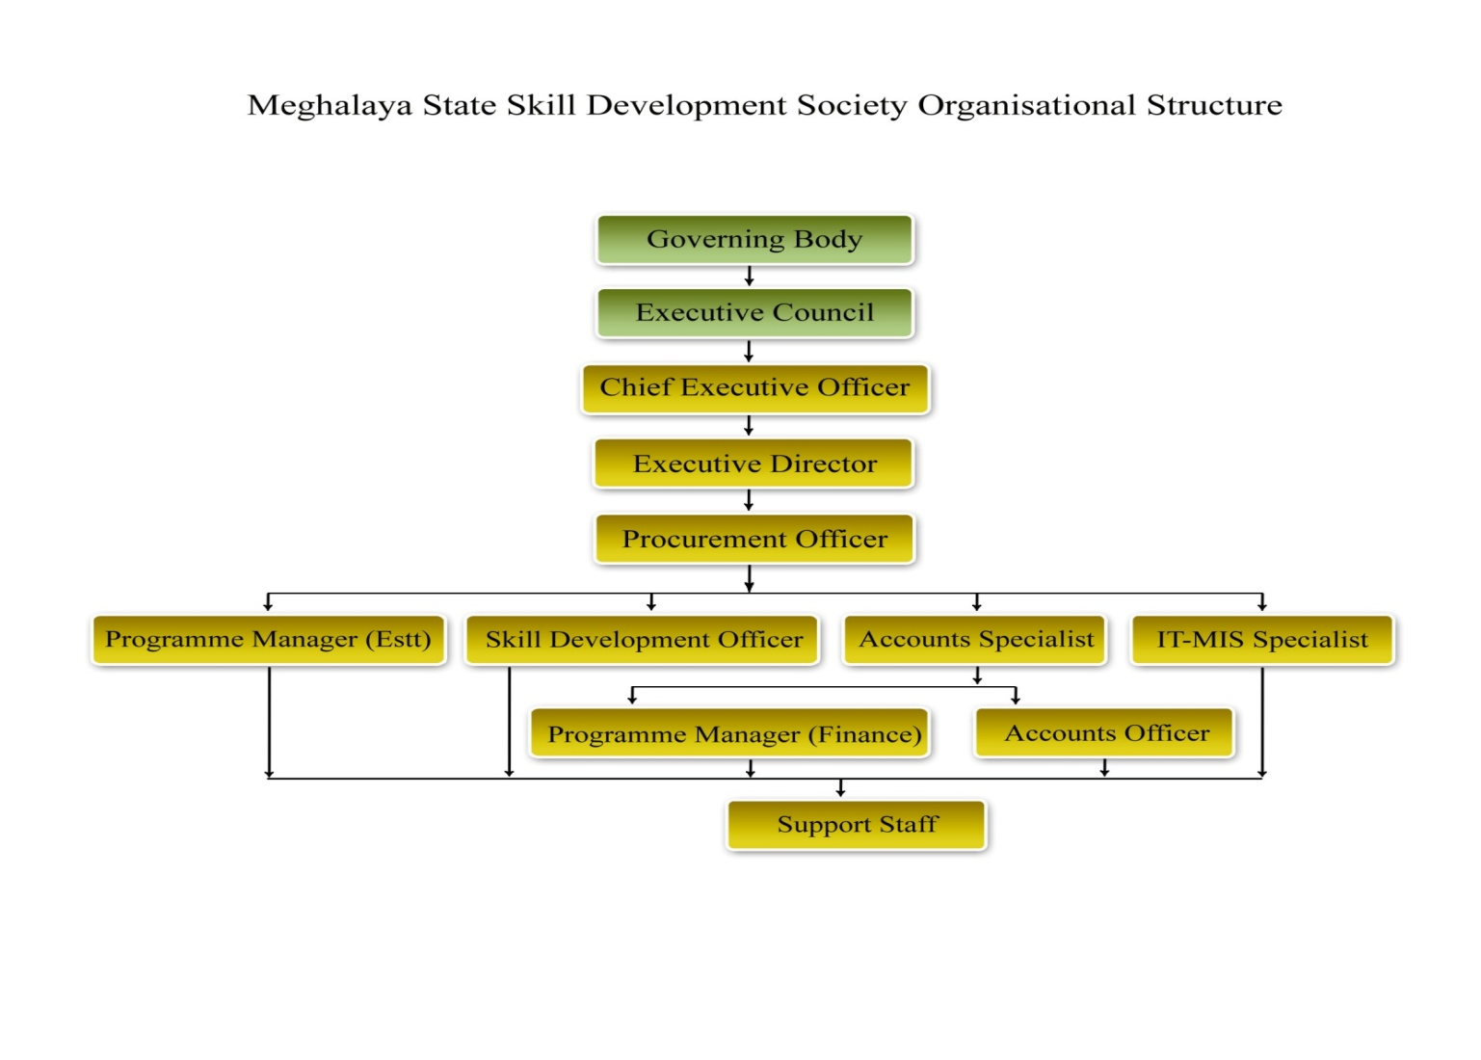
Organisational Structure

Slide 5
Placement Linked Skill Development programme conducted through the Ministry of Rural Development under Aajeevika Skill Development Programme (ASDP) FY 2012-2013 and 2013 -2014
Sl No | Project Implementation Agency | Total Trained | Total Placed
1. | DB Tech | 3574 | 2361
2. | IL&FS | 1314 | 769
3. | Future Corporate Resource Ltd. | 157 | 11
 | Total | 5045 | 3141

Slide 6
Status of Activities under MSSDS

Slide 7
Projects undertaken by the MSSDS
Projects | Targets | Candidates Trained | Candidates Placed
State Plan Project (2013 – 2015) Placement –Linked Skill Development Programme | 5000 | 1787 | 1157
Border Area Development Programme | 2550 | 1635 | 390
Backward Region Grant Fund (BRGF) | 140 | 90 | 52
Tourism | 250
NULM | 1245 | Yet to start
C&RD Department | 3870 | 3870 | 3870
Total | 13055 | 7382 | 5469

Slide 8
(a) State Plan Project (2013 -2015) – Placement-Linked Skill Development Programme
Sl No. | Project Implementation Agency (PIAs) | Target | Total Youth Trained | Total Placed
1. | Centum Learning Limited | 1000 | 103 | 57
2. | Polaris Solutions Enterprise | 200 | 55 | 31
3. | North Eastern Security Academy | 300 | 121 | 114
4. | NIPS School of Hotel Management | 500 | 119 | 30
5. | IL&FS | 1950 | 814 | 533
6. | S.S Netcom Pvt. Ltd | 600 | 324 | 204
7. | a. D.B Tech Society (Border Area) | 2550 | 915 | 390
 | b. D.B Tech Society (Non Border Area) | 450 | 251 | 188
 | Total | 7550 | 2702 | 1547

Slide 9
(B) Asian Development Bank (ADB)
MSSDS at present has also started working on the ADB project “Supporting Human Capital Development in Meghalaya”
Target – 60,000 youths
The targets mentioned below can vary
Wage employment Target – 45,000
Self- Employment Target – 15,000
Time period – 5 years

Slide 10
(c ) National Urban Livelihood Mission (NULM)
MSSDS is implementing the NULM project “Employment through Skills Training and Placement.”
Project duration – One year (2015-2016) w.e.f the date of signing of the MoU
Location:- Municipal Areas of Shillong, Jowai, Tura, Baghmara, Williamnagar and Resubelpara
Sl No. | PIA | Target Allotted
1. | S.S Netcom Pvt. Ltd | 306
2. | IL&FS Education Tech Services Ltd. | 366
3. | DB Tech Society | 413
4. | North Eastern Security Academy (NESA) | 160
 | Total | 1245

Slide 11
(d) Deen Dayal Upadhyaya – Grameen Kaushalya Yojana (DDU-GKY)
MSSDS is the nodal agency for MoRD projects dealing with the implementation of DDU-GKY in Meghalaya.
Two Skill Development Officers has been notified as Nodal Officers for handling the operations of the Project.
The Project is to be implemented as part of LIFE- MGNREGA in the next Financial Year.

Slide 12
Financial Assistance (2012 – 2015)
Sl. No | Particulars | Funds allotted
1. | Placement- Linked Skill Training Programme through the Deputy Commisioners | 20 Lakhs
2. | Placement-Linked Skill Training Programme through the SIRD for skill training in the Backward Region Grant Fund (BRGF) | Funded 140 youth at Rs. 4312/- per beneficiary
3. | Placement- Linked Skill Training through the Tourism Department | Funded 250 youth at Rs. 10,000/- per beneficiary

Slide 13
MSSDS’ Monitoring System
Assist - Mobilisation Drives
Awareness
Enrollment of potential candidates
Inspect – Training Programmes
PIAs
Inspections Tools (Checklist, Observational visits)
Track – Pre and Post Placement
Migration
Post Placement Tracking

Slide 14
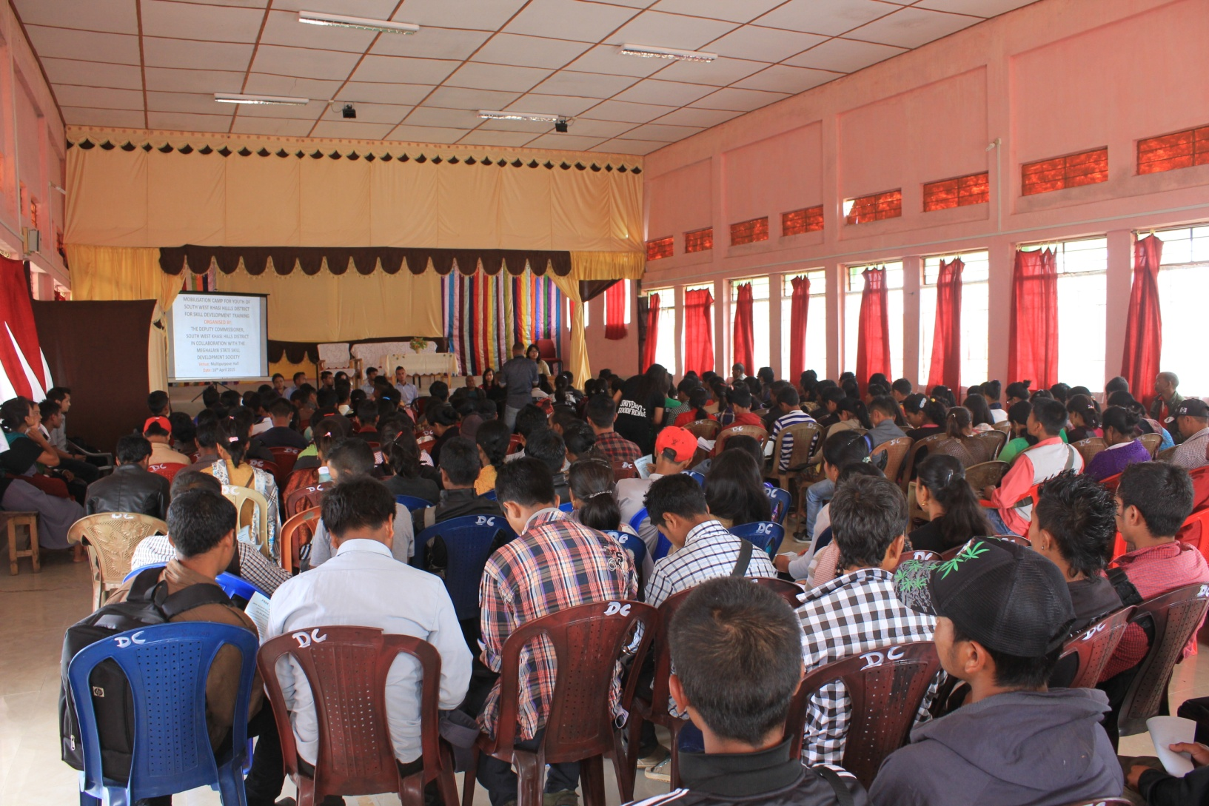
Mobilisation Drives

Slide 15
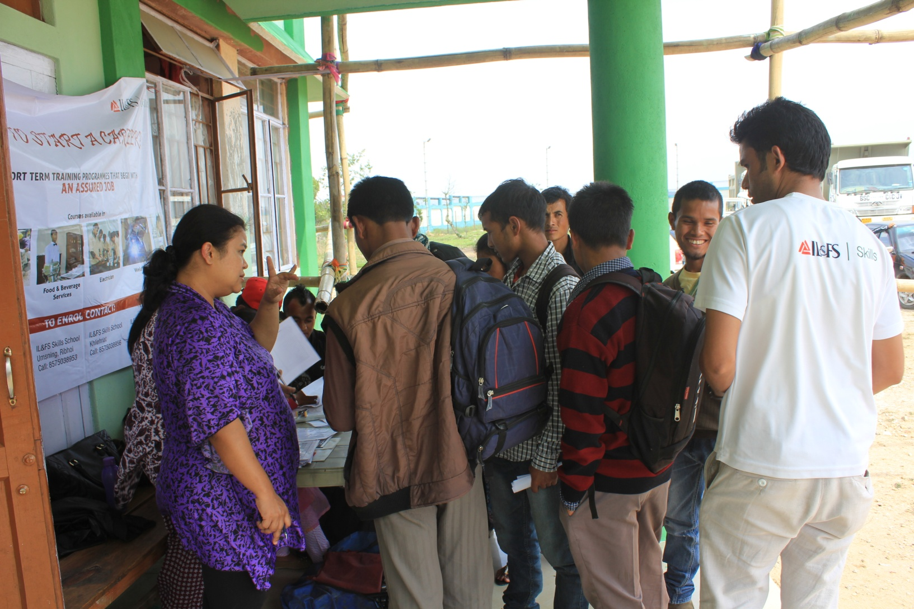

Slide 16
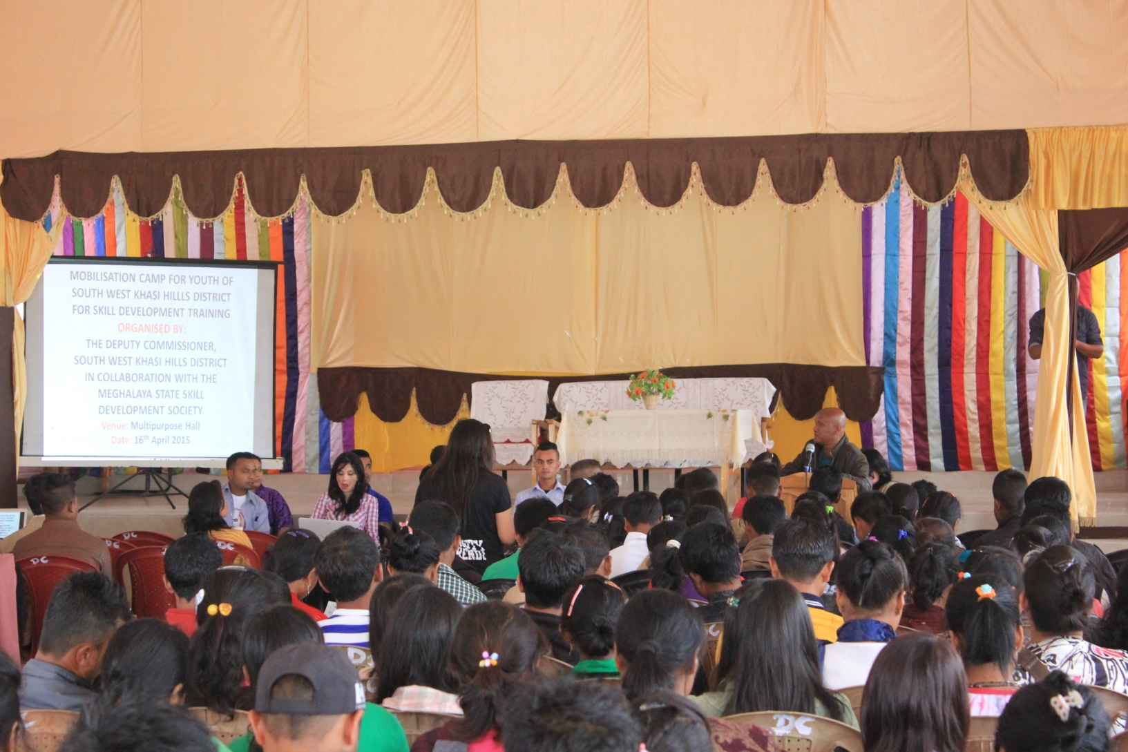

Slide 17
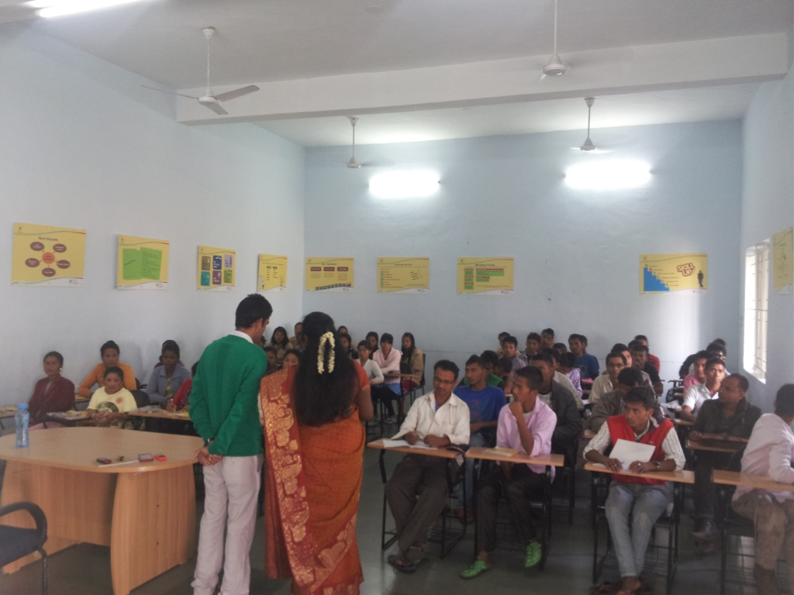
Training Centres

Slide 18
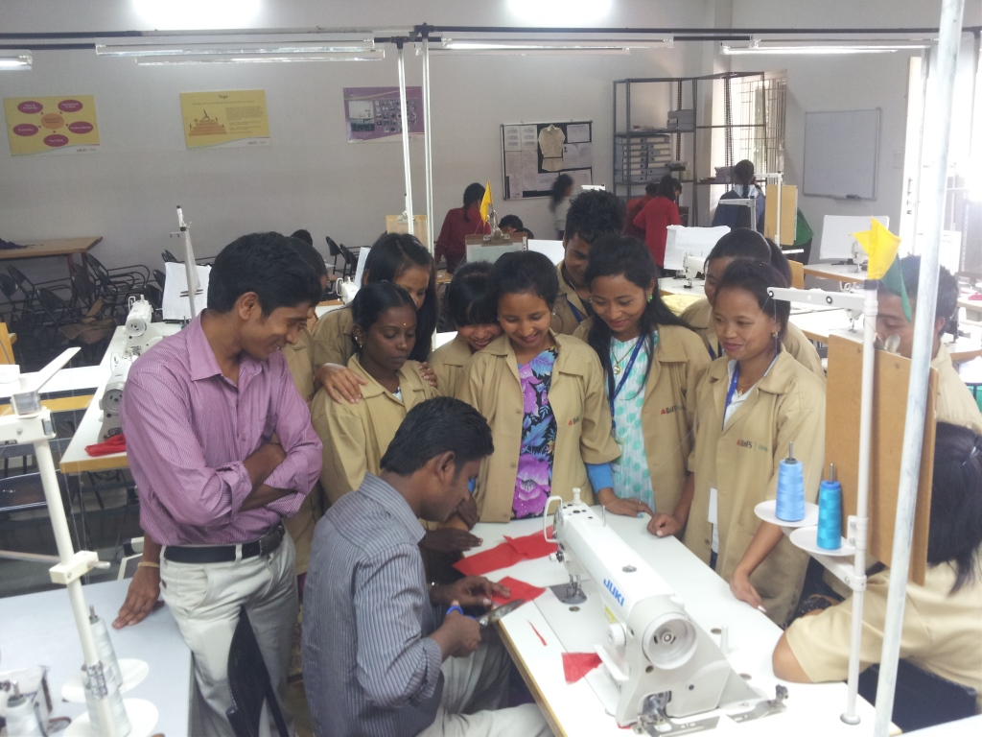

Slide 19
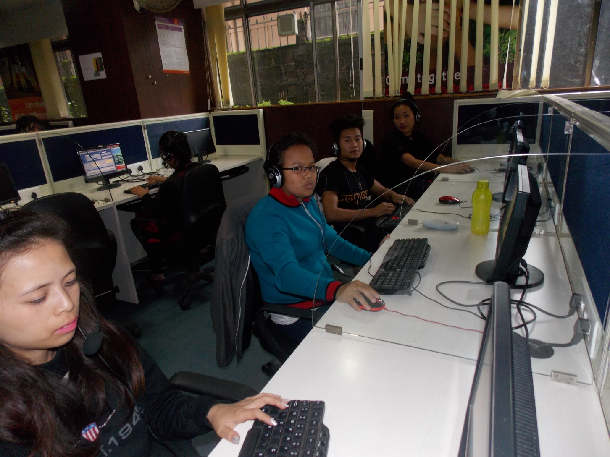

Slide 20
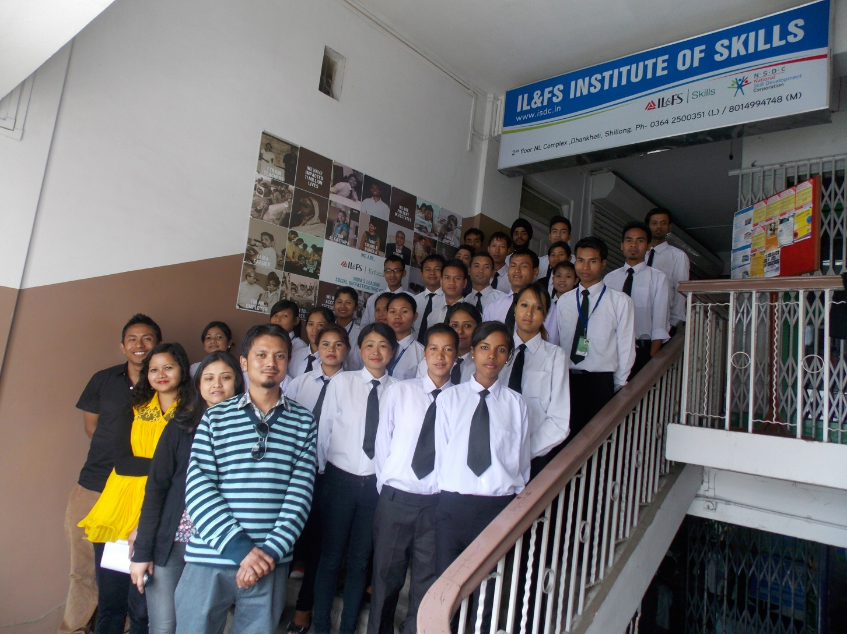

Slide 21
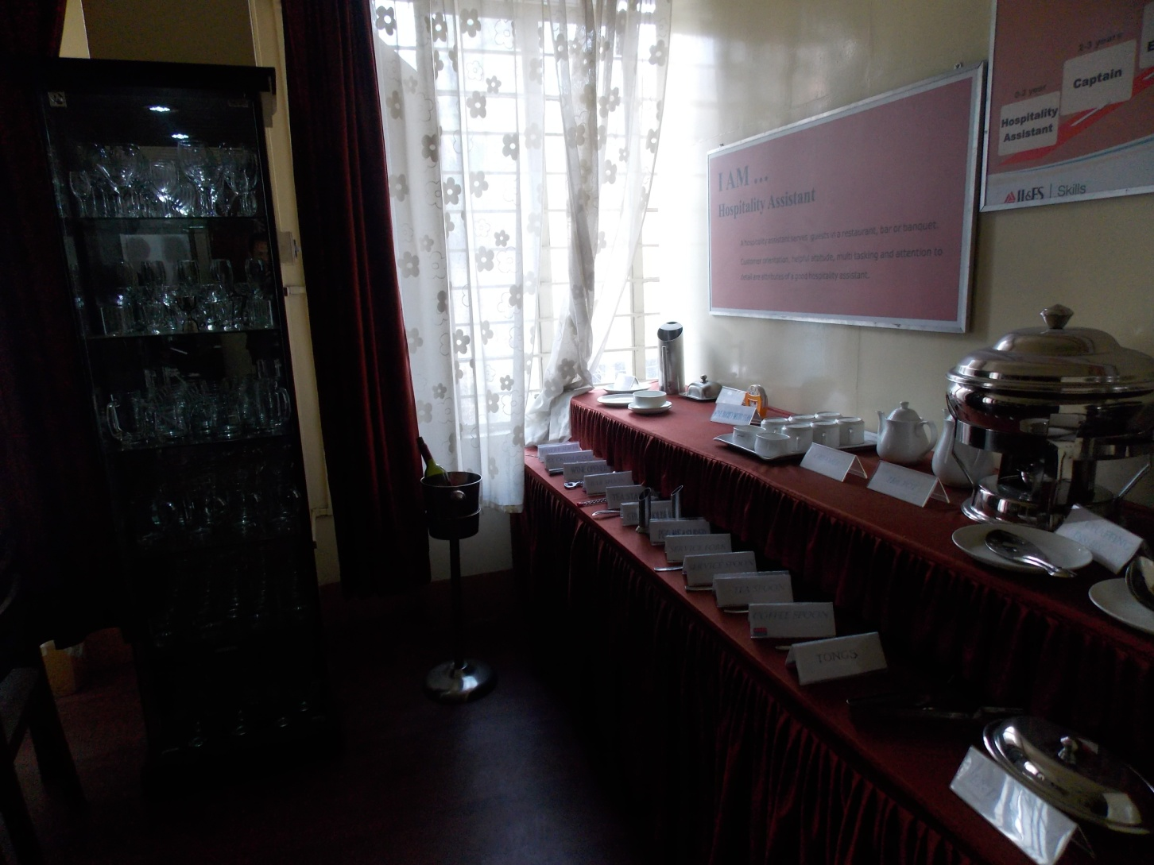

Slide 22
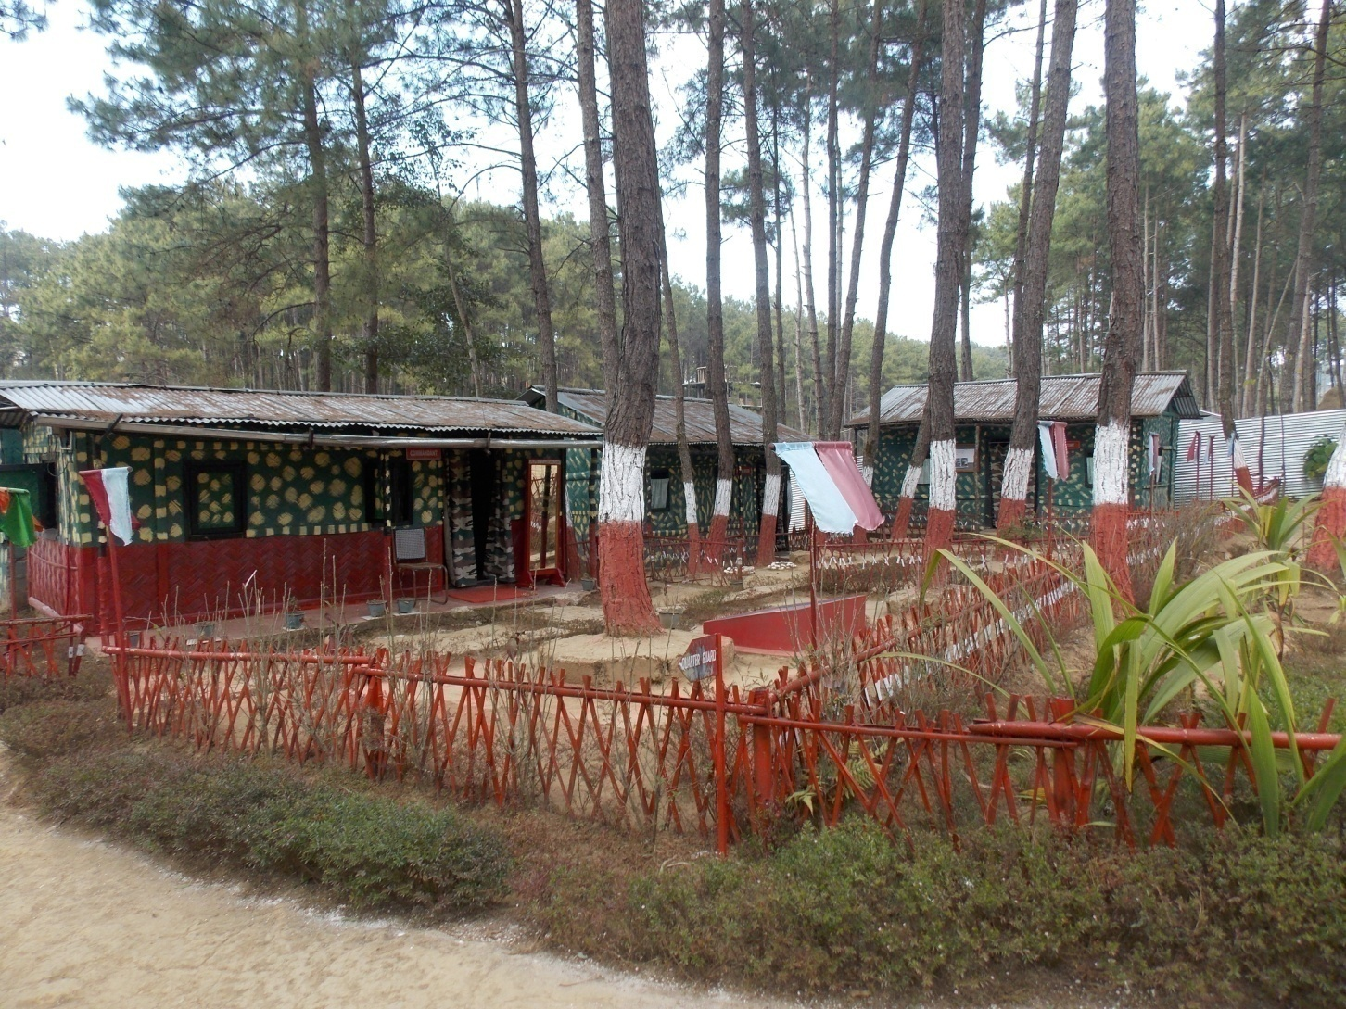

Slide 23
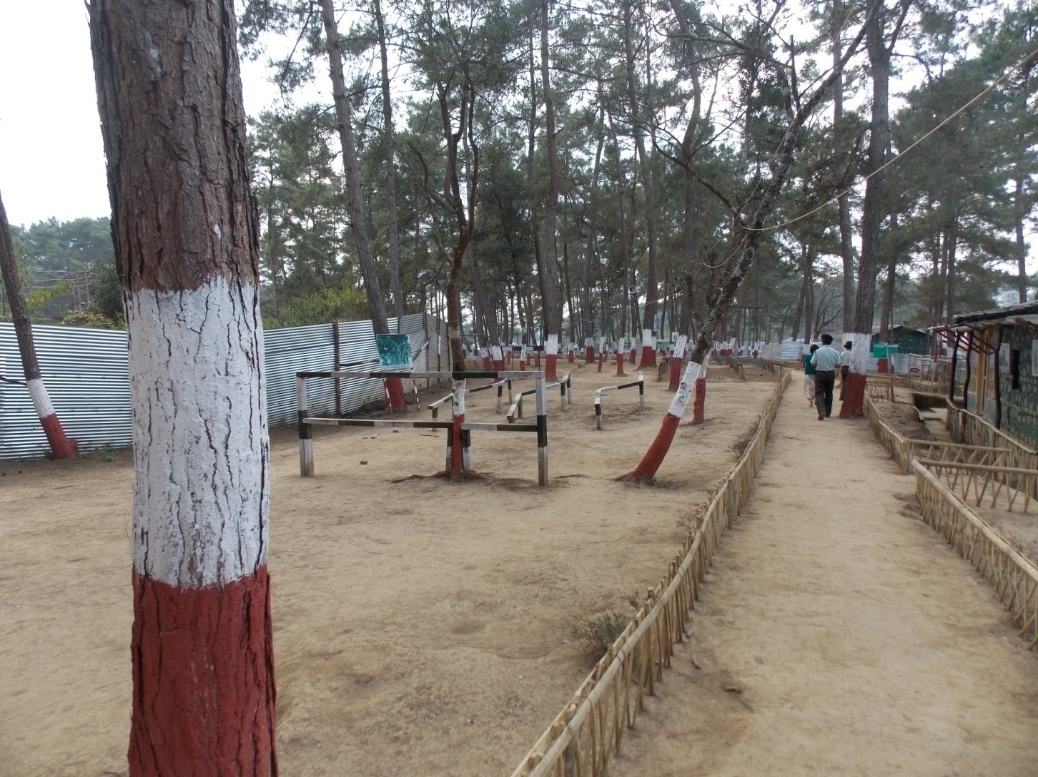

Slide 24
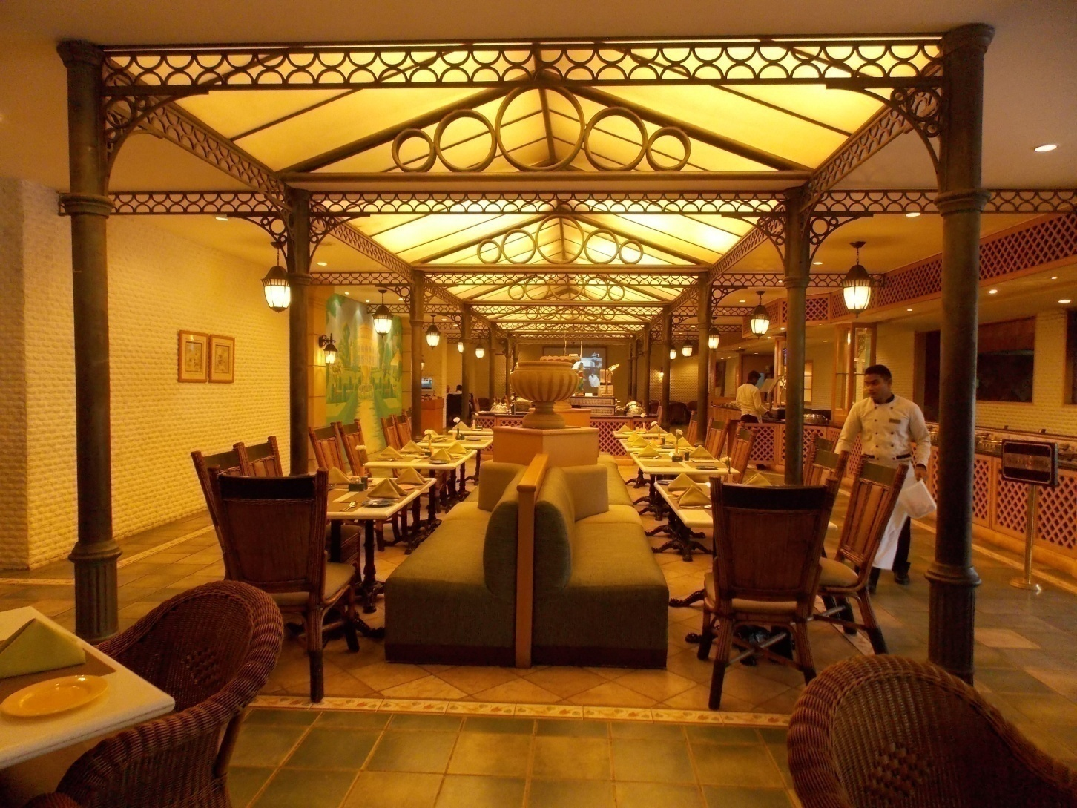
Placement Opportunities

Slide 25
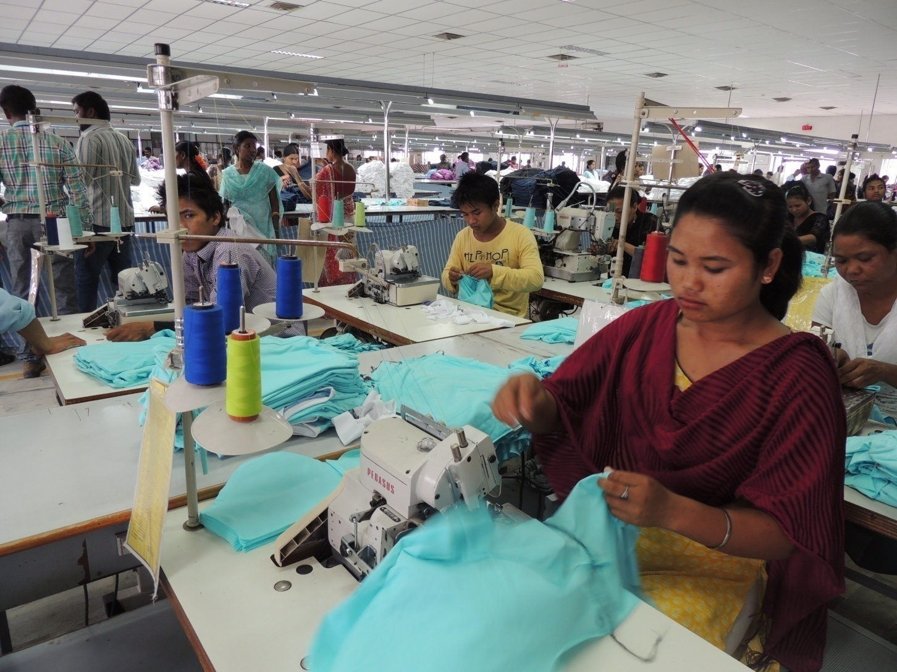

Slide 26
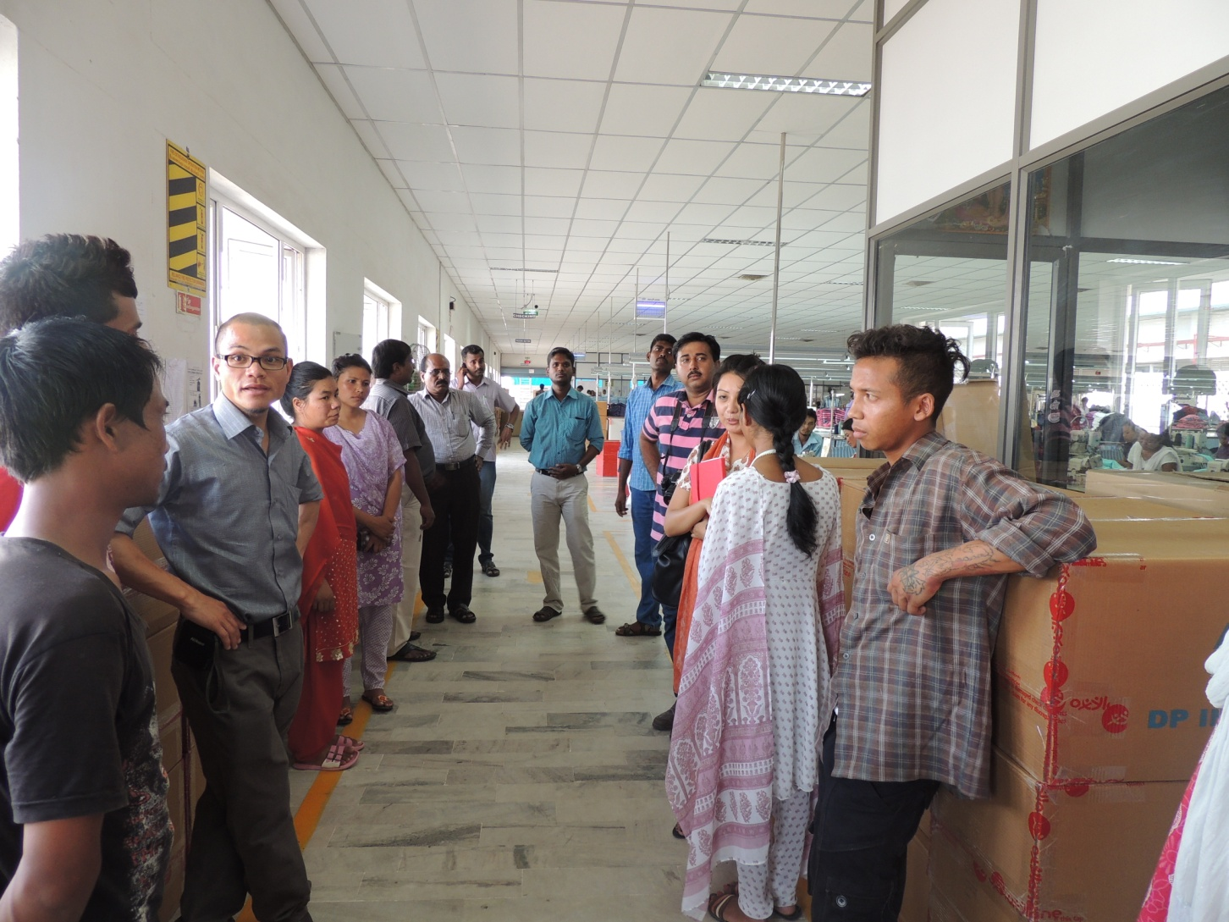
Interaction with placed candidates in their work place (at Arul Textiles, Coimbatore)

Slide 27
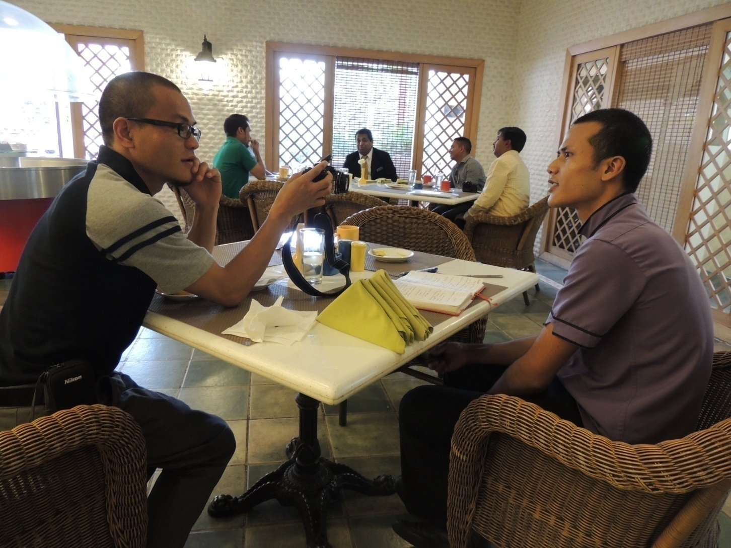
Interaction with Placed Candidates (at Hotel Residency, Coimbatore)

Slide 28
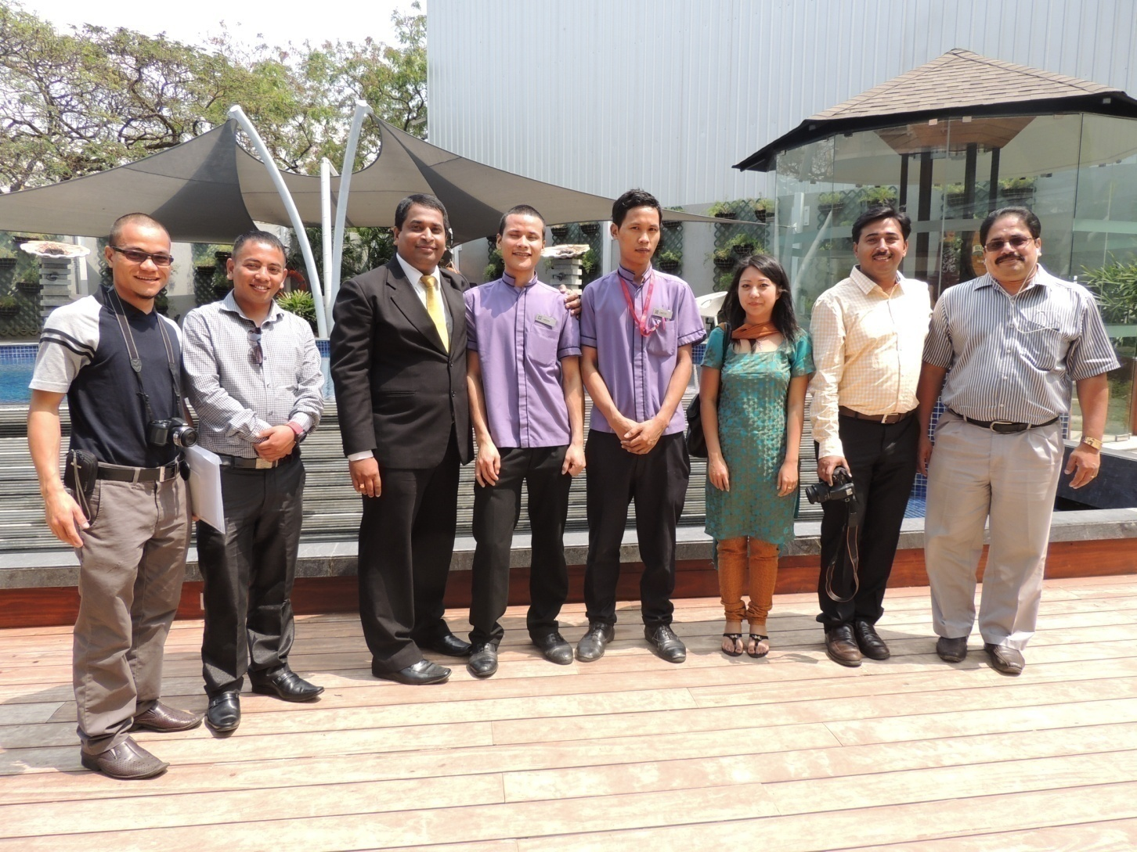

Slide 29
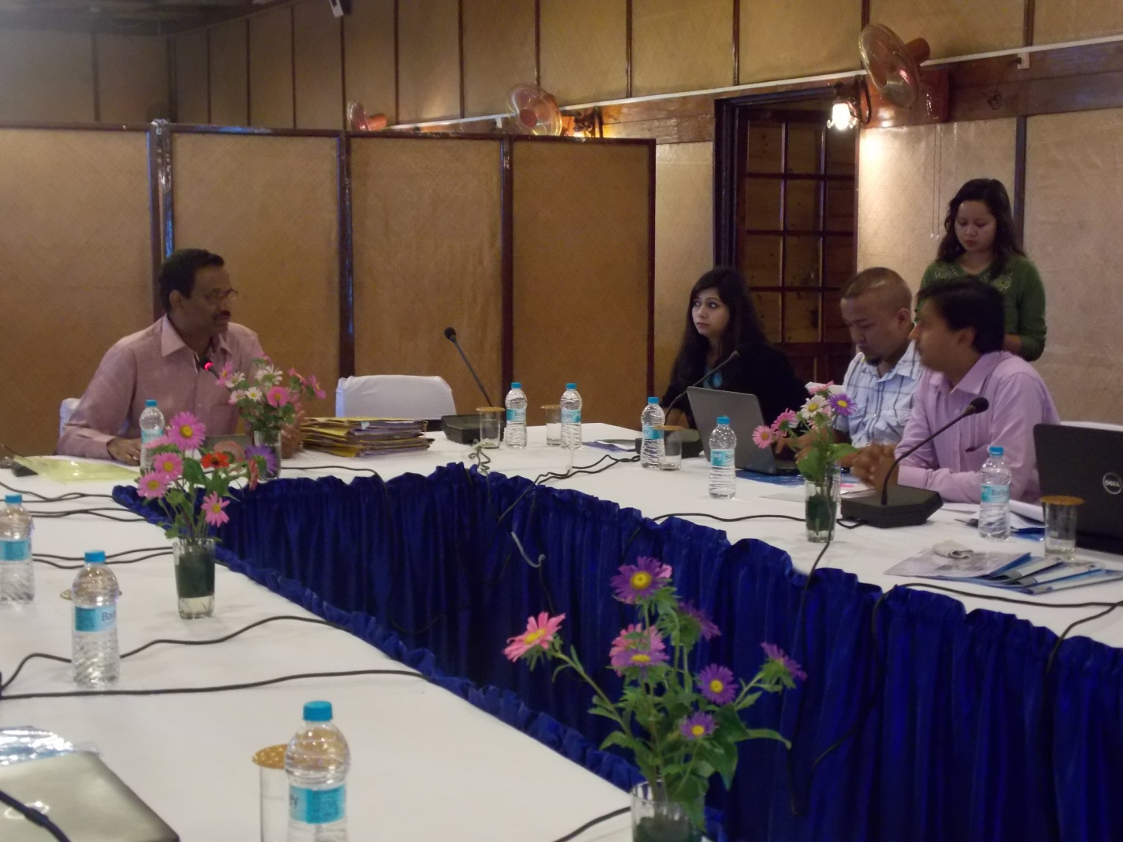
Review Meetings with PIAs held every quarter

Slide 30
Thank you

